Slide 1


Generative AI
Full Stack Developer

Slide 2
Course D : Agentic AI

Slide 3
04
Scientific Paper Agent using LangGraph
An intelligent research assistant for navigating and analyzing scientific literature

Slide 4

Agenda
The Research Challenge
Solution Overview
Key Components
System Architecture
Technical Stack
Agent Tools

Slide 5




The Research Challenge
Research Time
30-50%
Researchers spend 30–50% of R&D time reading, analyzing,
and synthesizing academic papers
Inefficient search processes across fragmented database
ecosystems
Complex task of synthesizing and connecting findings
across multiple papers
Resource-intensive maintenance of comprehensive literature
reviews
Ongoing effort required to stay current with new publications
Search Inefficiency
Synthesis Complexity
Update Burden

Slide 6




Solution Overview
LangGraph Research Flow
Decision Making
An LLM-powered, state-driven assistant built with
LangGraph
Integrates CORE API for broad paper access and PDF
processing
Plans, executes, and validates research steps with quality
gates
Human-in-the-loop option for critical review
Outcomes: Faster discovery, structured synthesis,
reproducible workflows
Planning
Tool Execution
Judge
Intelligent Research Assistant

Slide 7


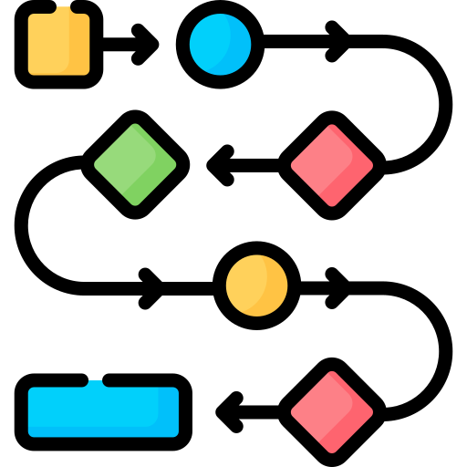
Solution Overview
State-Driven Workflow Engine
Five-node system for orchestrated research
Decision Making, Planning, Tool Execution, and Judge Nodes
Paper Processing Integration
CORE API for comprehensive paper access
PDFplumber for robust document processing and text extraction
Analysis Workflow
State-aware processing pipeline
Multi-step validation gates
Quality-focused improvement cycles
Human-in-the-loop validation options

Slide 8
System Architecture (LangGraph)
Nodes and flow:
- decision_making → planning → agent ↔ tools → judge → end
Conditional edges route based on:
- Research requirements
- Tool call presence
- Judge feedback (quality loops)
Decision Making
requires_reserach
Planning
Structured I/O with Pydantic models
Tool binding for controlled execution
Human-in-the-loop validation option
Feedback
Agent
Tool Calls
Tools
_good_answer
Judge
END

Slide 9





The Research Challenge
Orchestration
LangGraph (StateGraph, conditional edges)
LLM
OpenAI GPT-4o (tool calling; swappable with other LLMs)
Paper Access
CORE API (vast open-access repository)
Document Processing
pdfplumber (text extraction)
Data Models
Pydantic (structured inputs/outputs)
Environment/Utils
Python, dotenv, urllib3 (robust retries)

Slide 10



The Research Challenge
search-papers
@tool("search-papers", args_schema=SearchPapersInput)
def search_papers(query: str, max_papers: int = 1) -> str:
"""Search for scientific papers using the CORE API."""
try:
return
CoreAPIWrapper(top_k_results=max_papers).search(query)
except Exception as e:
return f"Error performing paper search: {e}"
search-papers (CORE API)
Input: {"query": string, "max_papers": 1–10}
Returns papers with IDs, titles, dates, authors, abstracts, URLs
download-paper (PDF → text)
Input: {"url": string}
Features: Robust retries, browser headers, page-wise extraction
download-papers
@tool("download-paper")
def download_paper(url: str) -> str:
"""Download a specific scientific paper from URL."""
try:
# Retry mechanism with browser headers
# PDF text extraction with pdfplumber
return text
except Exception as e:
return f"Error downloading paper: {e}"
ask-human-feedback
Solicits user input on errors/ambiguous steps
Called when encountering unexpected situations
Note: Extensive inline citations required in answers
ask-human-feedback
@tool("ask-human-feedback")
def ask_human_feedback(question: str) -> str:
"""Ask for human feedback when encountering errors."""
return input(question)

Slide 11





The Research Challenge
Step 1: Decision Making - Analyzes if query requires
research or direct response
Step 2: Planning - Creates detailed subtask plan with
appropriate tool selection
Step 3: Agent & Tools - Executes searches and paper
downloads; synthesizes content
Step 4: Judge - Evaluates answer quality; may loop
back for improvements (≤2 retries)
Step 5: Finalize - Produces comprehensive answer
with inline citations
Decision Making
Route to research or direct answer
Planning
Create research strategy
Agent & Tools
Search, download, synthesize
Judge
Evaluate quality, iterate if needed
Decision Making
Route to research or direct answer

Slide 12




Real-World Use Cases (PhD Research)
Paper Summarization
Download and analyze papers directly from URLs
Extract key findings with proper citations
Example Summarizing nanocarrier applications in cancer therapeutics
Finding Topic-Specific Papers
Comprehensive search with metadata extraction
Customizable result count (1-10 papers)
Example Finding 8 papers on quantum machine learning
Date-Filtered Research
CORE API query language for precise filtering
Complex queries for temporal analysis
Example Finding 2023-2024 papers on CRISPR for genetic disorders
Cross-Topic Analysis
Connecting findings across interdisciplinary domains
Focus on specific implementations or validations
Example Transformer architectures in protein folding prediction

Slide 13
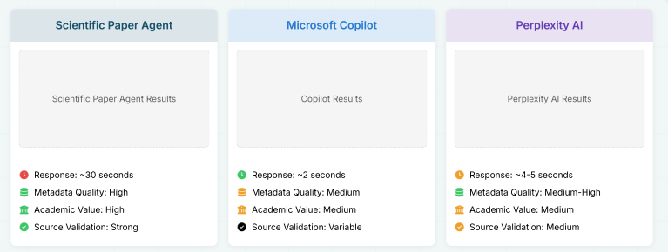
Performance Comparison
Comparative analysis between our Scientific Paper Agent and leading AI knowledge co-pilots, showing the trade-off
between depth and speed:
The comparison reveals a clear trade-off between response speed and research depth. Our agent prioritizes academic rigor and comprehensive
metadata at the cost of processing time, making it ideal for thorough academic research rather than quick exploratory searches.

Slide 14
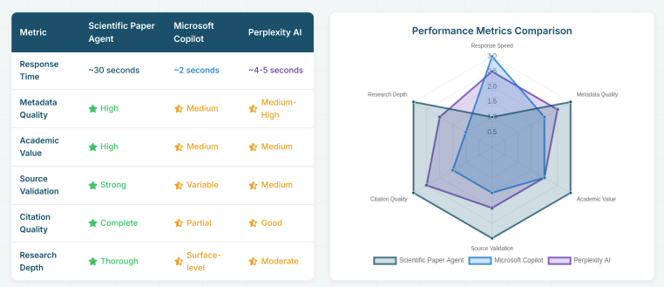
Comparative Metrics
Detailed performance metrics comparing our Scientific Paper Agent against leading alternatives based on standard research tasks:
The metrics reveal distinct strengths for different use cases: Our agent excels in thorough academic research with comprehensive validation, while
competitors offer advantages in speed for quick exploratory searches. The choice depends on whether the research task prioritizes depth or rapid
information retrieval.

Slide 15



Limitations & Challenges
Technical Limitations
API rate limits for paper access
Handle time for large PDFs
Limited to publicly accessible papers
Functional Limitations
No support for image analysis in papers
Limited context window for very long papers
Cannot perform mathematical derivations
Language constraints for non-English papers
Operational Constraints
Dependency on external APIs and services
Network reliability impacts performance
Authentication and access management complexity

Slide 16



Future Improvements
Technical Improvements
Implement parallel processing for multiple papers
Add caching system for frequently accessed papers
Integrate multiple academic APIs for broader coverage
Implement batch processing for large datasets
Functional Improvements
Add support for figure and table extraction
Implement cross-referencing between papers
Add citation network analysis capabilities
Include domain-specific validation rules
User Experience
Add interactive feedback mechanisms
Implement progress tracking for long-running tasks
Add customizable validation criteria
Include export options for research summaries

Slide 17




Key Takeaways
State-Driven Orchestration
LangGraph enables rigorous, reproducible research workflows
Conditional routing supports complex decision trees
Integrated Paper Access
Robust PDF processing streamlines academic analysis
Advanced retry mechanisms ensure reliable API connections
Quality Validation
Judge-and-improve loop raises answer quality
Inline citations provide academic credibility
Clear Trade-Off
Depth and validation over raw response speed
Optimized for thorough academic research, not instant answers

Slide 18
Q/A

Slide 19
Thanks

